Slide 1
IC Design Flow
Copyrights 2016 UIT-Khoa KTMT . All Rights Reserved.

Slide 2
AGENDA
Overview of chip
Basic Front-end Design Flow
Back-end Design Flow
Copyrights 2016 UIT-Khoa KTMT . All Rights Reserved.

Slide 3
Overview of chip
<Pic: Main board include IC, Chip, Resistor, Cap.>, highlight components by red square
Copyrights 2016 UIT-Khoa KTMT . All Rights Reserved.

Slide 4
Overview of chip
Basic element of chip
<Pic: Inverter symbol, cmos, layout>
Copyrights 2016 UIT-Khoa KTMT . All Rights Reserved.

Slide 5
Overview of chip
CMOS connection
Copyrights 2016 UIT-Khoa KTMT . All Rights Reserved.

Slide 6
Overview of chip
<Pic: Hierachy>
Copyrights 2016 UIT-Khoa KTMT . All Rights Reserved.

Slide 7
Overview of chip
VLSI (Very Large Scale Integration)
  It is the process of creating an Integrated circuit (IC) by combining thousands of transistors into a single chip
What is an ASIC (Application specific Integrated Circuit) ?
  If we design a Ics for the specific application is called an ASIC design
  Example of ASIC: Chip designed for a satellite, a car, a TV, etc.
What is a SoC (System on Chip) ?
  SoC = Chip + Software + Integration
    Chip: Embedded processor, ASIC Logics and analog circuitry
    Software: OS, Firmware, driver, protocol, etc.
    Integration: system solution, manufacture consultant, technical supporting.
Copyrights 2016 UIT-Khoa KTMT . All Rights Reserved.

Slide 8
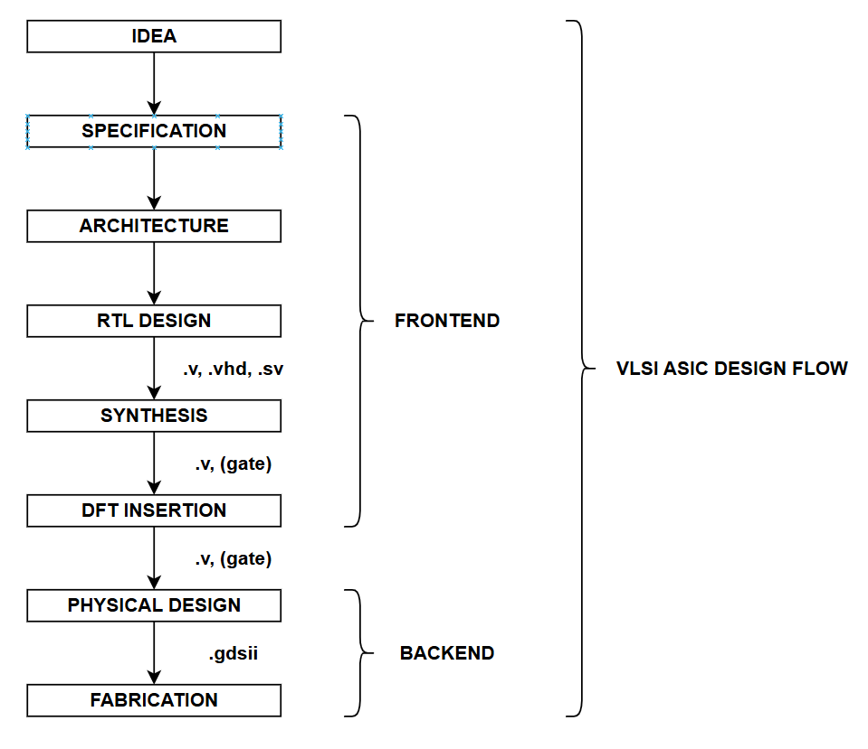
Overview of chip
Copyrights 2016 UIT-Khoa KTMT . All Rights Reserved.

Slide 9
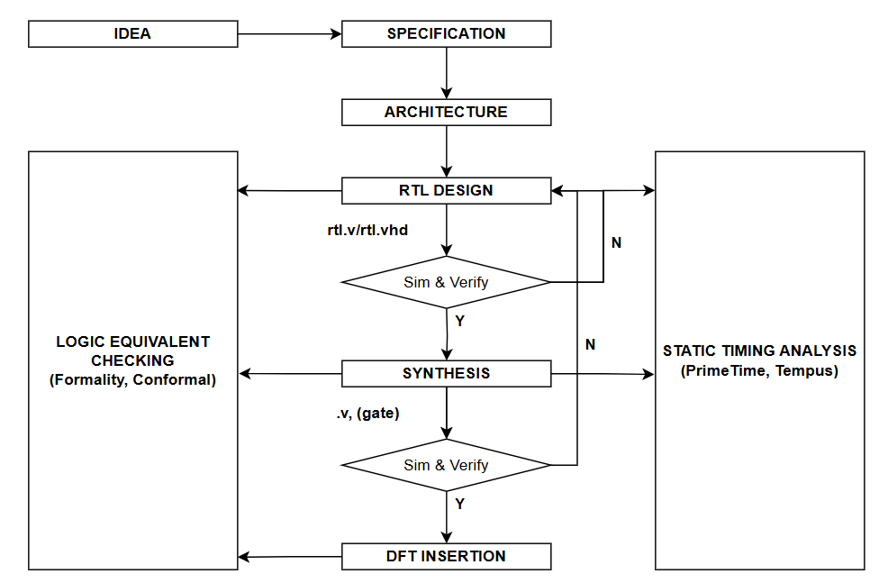
BASIC FRONT-END DESIGN FLOW
Copyrights 2016 UIT-Khoa KTMT . All Rights Reserved.

Slide 10
BASIC FRONT-END DESIGN FLOW
Specification
  The goal is to specify the functional requirements, the size of chip, power and speed for the design (PPA).
  Ex: idea for the phone-chip (can call & received, can search google.com, can play LOL, can use 2 days) → (call & Received module, wifi module, PLL high freq module, GPU module, Low power technique)
Architectural design
  The goal is to build algorithm, module connection basic on the specification.
  <Pic: flowchart show algorithm, architecture of the chip>
Copyrights 2016 UIT-Khoa KTMT . All Rights Reserved.

Slide 11
BASIC FRONT-END DESIGN FLOW
RTL (Register Transfer Level) Design
  The goal is to build components by using HDL’s (Verilog, VHDL) and simulate functional requirement using testbench
  <Pic: Code Verilog, Waveform simulation>
Synthesis
  The goal is to convert RTL to gate-level netlist and optimizing timing, area and power
  <Pic: code of RTL and code after synthesis>
Copyrights 2016 UIT-Khoa KTMT . All Rights Reserved.

Slide 12
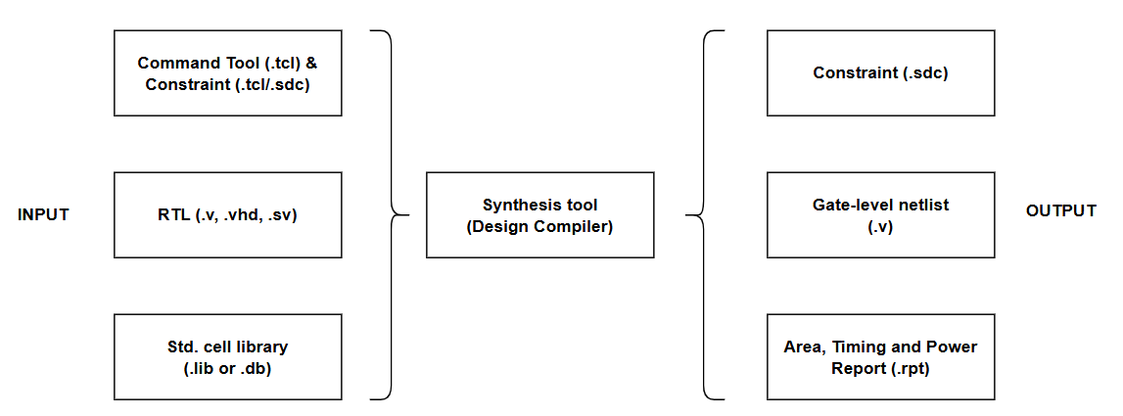
BASIC FRONT-END DESIGN FLOW
Synthesis Flow
  Command tool: specify operating condition and optimization
  Constraint:
    SDC (Synopsys Design Constraint): it is a format used to specify the design intent, including the timing, power and area constraints for the design
    Use for PPA optimization during Synthesis
  Std. cell lib.: specify logic cells during mapping
Copyrights 2016 UIT-Khoa KTMT . All Rights Reserved.

Slide 13
BASIC FRONT-END DESIGN FLOW
DFT
Copyrights 2016 UIT-Khoa KTMT . All Rights Reserved.

Slide 14
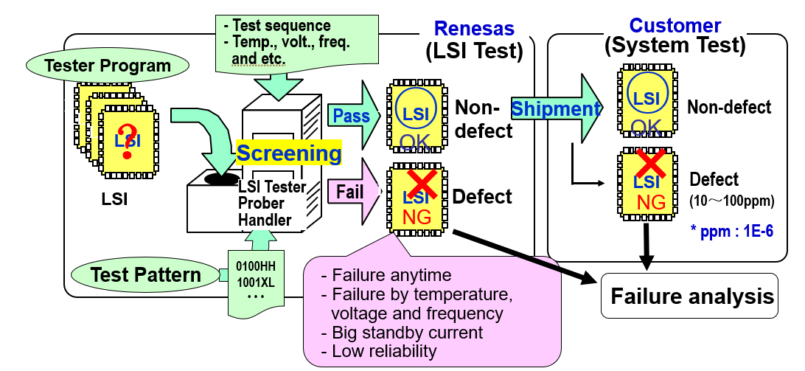
BASIC FRONT-END DESIGN FLOW
The goal is to make a test circuit inside LSI and improve the guarantee of product quality before providing to customers
ATE (Automation Test Equipment):
Copyrights 2016 UIT-Khoa KTMT . All Rights Reserved.

Slide 15
BASIC FRONT-END DESIGN FLOW
DFT Concept:
  MBIST: is design for test methodology
    Generate test pattern within LSI and compare with expectation values → output only pass/fail info from LSI
    Test frequency is determined within LSI
    Enable to design test circuit (BIST circuit) automatically
Copyrights 2016 UIT-Khoa KTMT . All Rights Reserved.

Slide 16
BASIC FRONT-END DESIGN FLOW
DFT Concept:
  SCAN:
    Is a technique used in DFT which help detecting defects in comb. circuit in LSI. This mean make sure the logic devices have no manufacturing faults that prevent their normal operations.
    In scan testing, seq. element of devices are connected into “scan chain” and used as primary IO for testing
Copyrights 2016 UIT-Khoa KTMT . All Rights Reserved.

Slide 17
BASIC FRONT-END DESIGN FLOW
Normal FFs & Scan FFs
  Only D-types FFs should be used, No other forms of asynchronous logic (JK, .etc)
Scan operation
  During scan_shift mode, SE (Scan Enable) is high and data latches from “SI -> Q”
  During functional/scan_capture, SE (Scan Enable) is low and data latches from “D->Q”
Copyrights 2016 UIT-Khoa KTMT . All Rights Reserved.

Slide 18
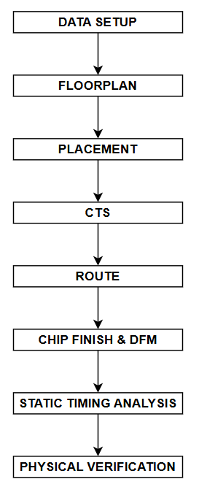
BACK-END DESIGN FLOW
Copyrights 2016 UIT-Khoa KTMT . All Rights Reserved.

Slide 19
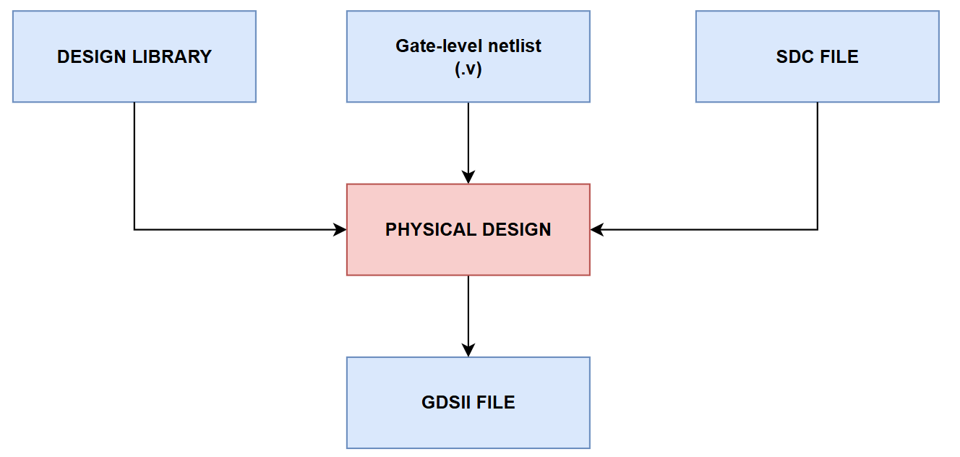
BACK-END DESIGN FLOW
Input/Output of Physical Design
  GDS = Graphic Database System
    It is a binary file format representing planar geometric shapes, text labels, and other information about the layout.
    Use for creating photo mark
Copyrights 2016 UIT-Khoa KTMT . All Rights Reserved.

Slide 20
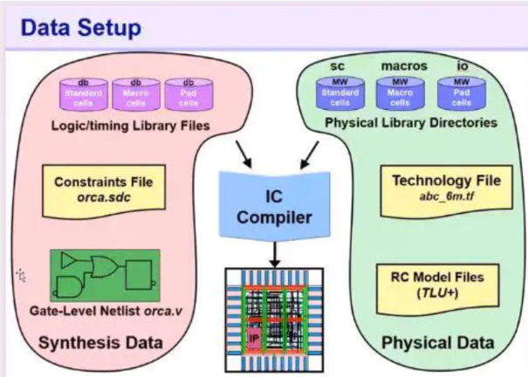
BACK-END DESIGN FLOW – Data setup
Data setup: prepare necessary inputs for starting Physical Design
ICC: EDA tool from Synopsys used for automatic PnR.
Copyrights 2016 UIT-Khoa KTMT . All Rights Reserved.

Slide 21
BACK-END DESIGN FLOW – Data setup
Logic lib. File
  Store info. About the function/timing of components
  Define drive/load design rules
    Max fanout
    Max transition, capacitance
Physical lib. Files
  Store info. Geometry of cell component:
    Size of cell
    Pins shape
    Pins layer
Copyrights 2016 UIT-Khoa KTMT . All Rights Reserved.

Slide 22
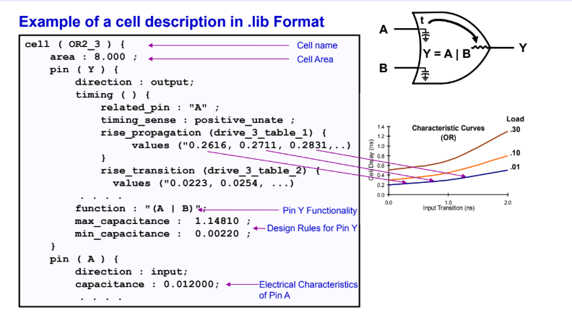
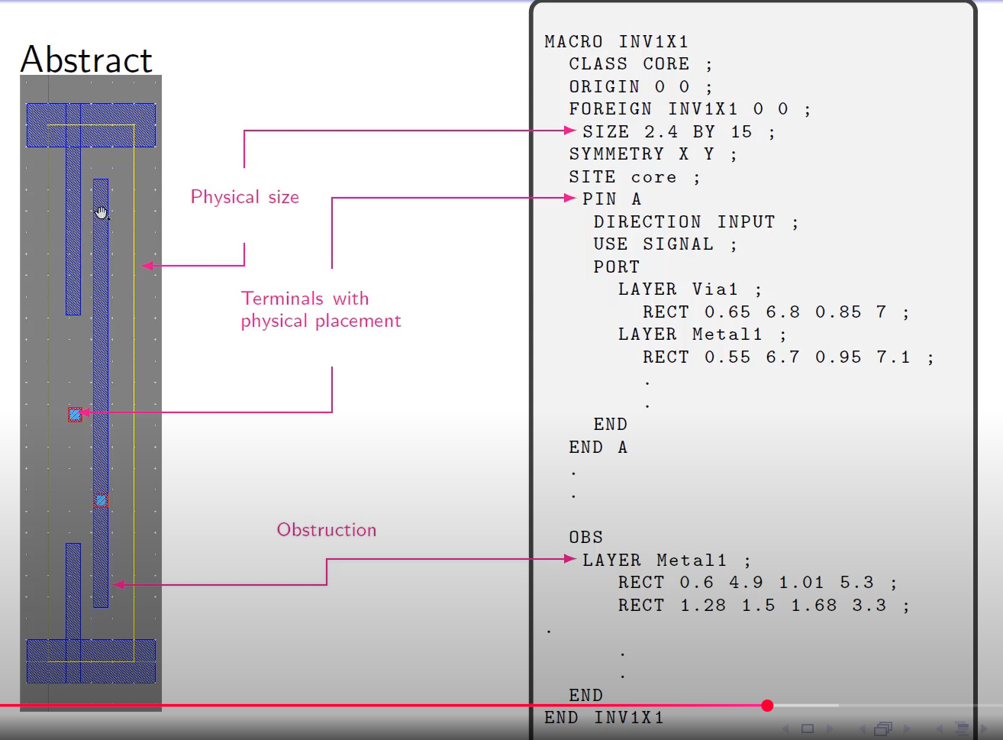
BACK-END DESIGN FLOW – Data setup
Logic Lib. Files:
  *.lib, *.def
Physical Lib. Files:
  *.lef, mw
Copyrights 2016 UIT-Khoa KTMT . All Rights Reserved.

Slide 23
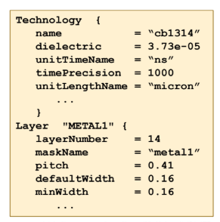
BACK-END DESIGN FLOW – Data setup
Technology file:
  Number, name, color, pattern designations for each layer/via Physical and electrical characteristics of each layer/via
  Design rules for each layer/via (minimum wire widths and wire-to-wire spacing, .etc)
Copyrights 2016 UIT-Khoa KTMT . All Rights Reserved.

Slide 24
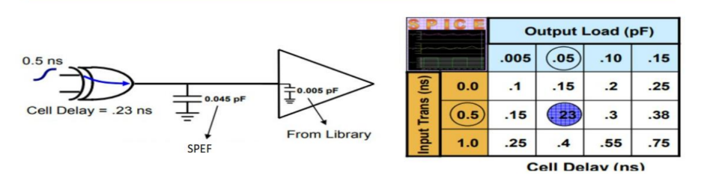
BACK-END DESIGN FLOW – Data setup
RC Model Files (TLU+):
  Specify the Resistance & Capacitance model files. Use for extracting net delay
  TLU: Table Look Up
Copyrights 2016 UIT-Khoa KTMT . All Rights Reserved.

Slide 25
BACK-END DESIGN FLOW - Floorplan
Major task in floorplaning
  Chip size decision
  IO pad arrangement
  Macro arrangement
  Module placement guidance
  Power Ground Structure creation
Goal
  Minimize chip size
  Routable
  Good for timing optimization
  Strong enough PG
Copyrights 2016 UIT-Khoa KTMT . All Rights Reserved.

Slide 26
BACK-END DESIGN FLOW - Floorplan
<Pic: Chip level placement>
Macros, PG straps, die, core, corner cells, std. cells, VDD ring, VSS ring IO Pads
Copyrights 2016 UIT-Khoa KTMT . All Rights Reserved.

Slide 27
BACK-END DESIGN FLOW - Floorplan
There are 3 basic cell types:
  IO cells
    Communicate btw chip & external word
    Location provided by PAD package designer
  Macro cells:
    A completed PD design: RAM, ROM, CPU, USB, SATA, PLL…
    Manually placed by PD designer
  Standard cells:
    The comb. logic: inverter, buffer, and, or, FF
    Placed automatically by EDA tool
There are 2 basic net types:
  Signal net: connect in/out pins btw IO, Macros, Std cells
  Power/Ground net: supply power for all device inside the chip: VDD/VSS
Copyrights 2016 UIT-Khoa KTMT . All Rights Reserved.

Slide 28
BACK-END DESIGN FLOW - Floorplan
The power/ground structure inside the chip
  There are 3 PG net type:
    Ring: route around the core of the chip and supply for strap nets
    Strap: route as network and supply for rail nets
    Rail: route horizontally and supply for standard cells
Copyrights 2016 UIT-Khoa KTMT . All Rights Reserved.

Slide 29
BACK-END DESIGN FLOW - Floorplan
The power and ground specification
  We got from customer or power analysis team (checking IR drop, checking EM) or adjusting value base on congestion information
Copyrights 2016 UIT-Khoa KTMT . All Rights Reserved.

Slide 30
BACK-END DESIGN FLOW - Floorplan
The way to supply power depend on how to package a chip
  Wirebond
  Flipchip
Copyrights 2016 UIT-Khoa KTMT . All Rights Reserved.

Slide 31
BACK-END DESIGN FLOW - Floorplan
<Layout of wirebond, flipchip power)
Copyrights 2016 UIT-Khoa KTMT . All Rights Reserved.

Slide 32
BACK-END DESIGN FLOW - Floorplan
<Example routing specification>
Copyrights 2016 UIT-Khoa KTMT . All Rights Reserved.

Slide 33
BACK-END DESIGN FLOW - Placement
The placement unit
  Row:
    The core area is divided into the rows. It can be single row, double row or triple row
    The height of row is equal to the height of std.cell that it is a constant and width varies
    The tool will put std cells on row in order to avoid overlap following Y-axis
  Site:
    Each row is divided into the sites. Site is a minimum unit
    The width of std cell is multiple of site
    The tool will move std cells to site in order to avoid overlap following X-axis
  The row and site information got from tech lef file
Copyrights 2016 UIT-Khoa KTMT . All Rights Reserved.

Slide 34
BACK-END DESIGN FLOW - Placement
What does the placement do ?
  Put standard cells into the core automatically
  Timing opt.: reduce cell delay on data path
  Route opt. (congestion): spread cells, module distribution…
  DRV opt.: transition, fanout, capacitance
  Power opt., area opt.
Copyrights 2016 UIT-Khoa KTMT . All Rights Reserved.

Slide 35
BACK-END DESIGN FLOW - Placement
What does the placement do ?
  Put standard cells into the core automatically
  Timing opt.: reduce cell delay on data path
  Route opt. (congestion): spread cells, module distribution…
  DRV opt.: transition, fanout, capacitance
  Power opt., area opt.
Copyrights 2016 UIT-Khoa KTMT . All Rights Reserved.

Slide 36
BACK-END DESIGN FLOW - Placement
How does placement optimization ?
  Timing optimization (setup timing):
    Place cells closer together
    Change logic structure to shorten
    Up size cell
Copyrights 2016 UIT-Khoa KTMT . All Rights Reserved.

Slide 37
BACK-END DESIGN FLOW - Placement
What timing path look like after placement ?
  Clocks are treated as Ideal (clk1, clk2 are supposed to rise/fall at the same time)
Copyrights 2016 UIT-Khoa KTMT . All Rights Reserved.

Slide 38
BACK-END DESIGN FLOW - Placement
Timing optimization
  Opt. std cells locations to reduce congestion
  Congestion is number of routing tracks available for routing in one particular area is less than the required routing tracks
Copyrights 2016 UIT-Khoa KTMT . All Rights Reserved.

Slide 39
BACK-END DESIGN FLOW - Placement
Example for congestion map result
Copyrights 2016 UIT-Khoa KTMT . All Rights Reserved.

Slide 40
BACK-END DESIGN FLOW – CTS
How does the clock path look like in propagation ?
  Ideal
  Propagation
Copyrights 2016 UIT-Khoa KTMT . All Rights Reserved.

Slide 41
BACK-END DESIGN FLOW – CTS
Concept in CTS:
  Latency: the amount of time from the clock origin point to the sync pin of the flop
  Local skew the different in the arrival of clk signal at the clock pin of related flops
  Global skew: the diff. btw shortest & longest clk path delay
Copyrights 2016 UIT-Khoa KTMT . All Rights Reserved.

Slide 42
BACK-END DESIGN FLOW – CTS
What does CTS do ?
  Build clock tree following H-tree model (using inverter or buffer cells for inserting)
  Fixing DRV
  Minimizing clock latency (shortest) and skew (~ 0)
Copyrights 2016 UIT-Khoa KTMT . All Rights Reserved.

Slide 43
BACK-END DESIGN FLOW – routing
What’s inside a chip – Cmos connected
  Routing: connect with real metal (physical connection)
Copyrights 2016 UIT-Khoa KTMT . All Rights Reserved.

Slide 44
BACK-END DESIGN FLOW – routing
Important concepts related to routing
  Routing track
  Routing direction
  Routing rule
  Metal spacing, metal width
Copyrights 2016 UIT-Khoa KTMT . All Rights Reserved.

Slide 45
BACK-END DESIGN FLOW – routing
To complete routing ICC process 3 main steps + 1 optional step
  Global routing
    Create G-cells (global routing cells)
    GR assigns nets to specific metal layer
    Congestion improvement
Copyrights 2016 UIT-Khoa KTMT . All Rights Reserved.

Slide 46
BACK-END DESIGN FLOW – routing
Congestion improvement:
  GR tries to avoid congested Gcells while minimizing detours
    Congestion exists when more tracks are needed than available
    Detour increase wire length (delay)
  GR also avoids:
    PG (ring/strap/rail)
    Routing blockages: it is a region where routing is not allowed on specific layers
Copyrights 2016 UIT-Khoa KTMT . All Rights Reserved.

Slide 47
BACK-END DESIGN FLOW – routing
Result of global routing
  Congestion map
  No real metal routed yet
Copyrights 2016 UIT-Khoa KTMT . All Rights Reserved.

Slide 48
BACK-END DESIGN FLOW – routing
Track assignment
  Assign layer for each net (actual metals)
  Do not check DRC (design rule check)
    Spacing violation, min-area violation, overlapping wire
Copyrights 2016 UIT-Khoa KTMT . All Rights Reserved.

Slide 49
BACK-END DESIGN FLOW – routing
Detail routing
  Divided chip into Sboxes and look for DRC violations in each Sbox
  It rips up the wire and reroute it to fix violation
  If a Sbox is congested, DRC cannot clean
Copyrights 2016 UIT-Khoa KTMT . All Rights Reserved.

Slide 50
BACK-END DESIGN FLOW – routing
Search & Prepare (optional)
  Start to reroute with smaller Sbox (compare to Sbox in detail routing) (1)
  Enlarge Sbox and reroute until cover chip (2)
  Redo loops of (1) & (2) ➔ user define the number of loops
Can get more routing resource once enlarge Sbox
The bigger Sbox the longer detour nets, can fixx more DRC violation ➔ trade off btw routing & timing.
Copyrights 2016 UIT-Khoa KTMT . All Rights Reserved.

Slide 51
BACK-END DESIGN FLOW – Chip finish
Double via insertion (redundant via insertion)
  Redundant via insertion is an important DFM feature that is supported by Zroute throughout the routing flow. The redundant via result is measured by the redundant via conversion rate, which is defined as the percentage of single vias converted into redundant vias.
Copyrights 2016 UIT-Khoa KTMT . All Rights Reserved.

Slide 52
BACK-END DESIGN FLOW – Chip finish
Wire spreading
  Spreading wires in non-DRC violation area to reduce defections in manufacturing process.
Copyrights 2016 UIT-Khoa KTMT . All Rights Reserved.

Slide 53
BACK-END DESIGN FLOW – Chip finish
Filter cell insertion
  There are 2 lists of filter cells
    With metal: DCAP cells (decoupling capacitor cells)
      Reducing: dynamic IR drops
    Without metal: FILL cells
      Reducing the DRC violation created by they base layer (N-well, P+, N+)
      To maintain the power rail, N-well and implant layer connection continuity
Copyrights 2016 UIT-Khoa KTMT . All Rights Reserved.

Slide 54
BACK-END DESIGN FLOW – Chip finish
How does the filter cell insert
  Filter cells used to fill these spaces btw regular lib cell
  This is one of Fab constraints, for ease in the generation of the masks
Copyrights 2016 UIT-Khoa KTMT . All Rights Reserved.

Slide 55
BACK-END DESIGN FLOW – Chip finish
Metal fill insertion
  Some problems happen due to matal density (more or less)
    Metal over etching
    Metal
Copyrights 2016 UIT-Khoa KTMT . All Rights Reserved.

Slide 56
BACK-END DESIGN FLOW – Chip finish
Metal over etching
  A metal wire in low metal density region receives a higher ratio of etchant can get over-etched
Copyrights 2016 UIT-Khoa KTMT . All Rights Reserved.

Slide 57
BACK-END DESIGN FLOW – Chip finish
Metal erosion
  The wafer is made flat (planarized) by a process called Chemical Mechanical Polishing (CMP)
  CMP leaves metal tops with a concave shape – dishing
    The wider the matal the more pronounced the dishing
    Very wide traces can become quite thin – dishing this severe is called erosion
Copyrights 2016 UIT-Khoa KTMT . All Rights Reserved.

Slide 58
BACK-END DESIGN FLOW – Chip finish
Solution for these problems:
  Metal over etching => metal filling
  Metal erosion => metal sloting
  Metal liftoff => metal sloting
Copyrights 2016 UIT-Khoa KTMT . All Rights Reserved.

Slide 59
BACK-END DESIGN FLOW – Chip finish
Metal slotting
  Slots minimize stress build up, reducing liftoff tendency
  Dielectric in wide wires improves resistance to erosion
  Primarily used on PG traces
Copyrights 2016 UIT-Khoa KTMT . All Rights Reserved.

Slide 60
BACK-END DESIGN FLOW – STA
Static Timing Analysis (STA) is a method for determining if a circuit meets timing constraints without having to simulate
Basic timing constraint
  Setup timing
  Hold timing
  Max transition
  Max capacitance
  Max fanout
Copyrights 2016 UIT-Khoa KTMT . All Rights Reserved.

Slide 61
BACK-END DESIGN FLOW – STA
Timing Analysis is not only done at final phases
  Floorplaning (ICC): zero inter connection timing
  After Placement (ICC): Ideal timing, net is base on global route Propagated
  CTS (ICC): timing, net is base on the global route
  Routing (ICC): Propagated timing, net is base on real metal
  STA (PrimeTime, StartRC): Propagated timing, net is base on real metal
Copyrights 2016 UIT-Khoa KTMT . All Rights Reserved.

Slide 62
BACK-END DESIGN FLOW – STA
Copyrights 2016 UIT-Khoa KTMT . All Rights Reserved.

Slide 63
THANK YOU
Copyrights 2016 UIT-Khoa KTMT . All Rights Reserved.

